Slide 1

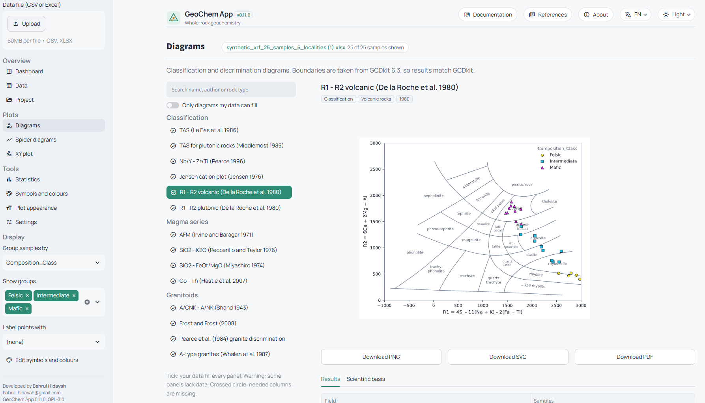
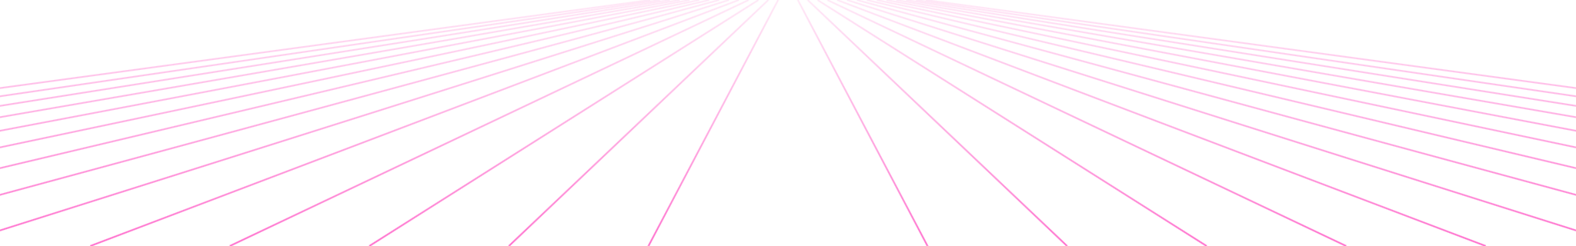
GeoChem
App
HOKKAIDO UNIVERSITY // 2026
ジオケム・アプリ
geochem_app.exe
A free web application for whole-rock geochemistry
Bahrul Hidayah · Geology and Resources Engineering
> geo-app-hidayah.streamlit.app_
Notes:
Good afternoon. Today I will present GeoChem App, a free web application I am building for whole-rock geochemistry. On the right is the real app: the Diagrams page with an R1–R2 classification of 25 test samples. The app is online now at the link shown, so you can try it during or after this talk.

Slide 2



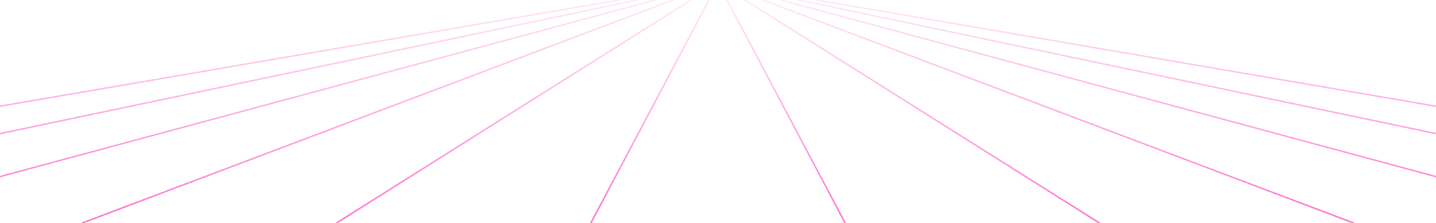
The problem
// INTRODUCTION
Costly licences
Coding required
Scattered sources
Commercial geochemistry packages charge per seat or per year, which is hard for students and small labs.
Free tools exist, but most need scripting in R or Python before the first plot appears.
Field boundaries are spread across many papers, so diagrams are often still traced by hand.
GEOCHEM_APP.EXE · B. HIDAYAH
02 / 16
Notes:
Whole-rock geochemistry relies on classification and discrimination diagrams. The software commonly used for this has three problems. Commercial packages are expensive. Free tools usually need programming before you get a single plot. And the diagrams themselves are spread across many papers, so many people still trace boundaries by hand, which is slow and error-prone.

Slide 3
One free tool that is easy to use and scientifically defensible.
// THE GOAL
Free and open source
Easy for beginners
Built on published science
GPL-3.0 licence: anyone can use, study, share and improve it.
Upload a lab file and click. No coding and no installation needed.
IUGS recommendations, original classification papers and standard normalising values.
GEOCHEM_APP.EXE · B. HIDAYAH
03 / 16
Notes:
So the goal is one tool that is free, easy, and still rigorous enough for a thesis or a paper. It is open source under GPL-3.0. It needs no coding. And everything in it comes from widely used, published sources: IUGS recommendations, the original classification papers, and standard normalising values.

Slide 4
Design principles
// HOW IT WORKS
Science separate from the interface
01
All geochemistry lives in a plain-Python package. The web page only arranges buttons, so the science can be tested and reused.
Diagrams are data
02
Axis formulas, boundary lines and field names are stored as data files. One plotting engine draws every diagram.
Traceable to the source
03
Every diagram carries its original reference and formulas. Calculations are checked against published values.
GEOCHEM_APP.EXE · B. HIDAYAH
04 / 16
Notes:
Three principles guide the design. First, the science code is kept separate from the web interface, like keeping lab procedures separate from the report layout. Second, each diagram is stored as data, not as drawing code, so adding a new diagram means adding coordinates and formulas, not programming. Third, everything is traceable: each diagram shows its formulas and original reference.

Slide 5
Architecture: four layers
// HOW IT WORKS
Runtime
Web browser, any device
Streamlit Community Cloud
Portable Windows ZIP
Desktop
where it runs
Interface
Pages
Sidebar
Top bar
Session memory
English, Indonesian, Japanese
app.py · Streamlit
Science
data: read and clean
calc: FeOt, Mg#, anhydrous
norms: CIPW norm
catalog: 27 diagrams
geochem/ · plain Python
plotting: one engine
xrfqc: XRF module
Data
Boundaries and fields (JSON)
Normalising values (JSON)
Reference materials (CSV)
Manual
files
GEOCHEM_APP.EXE · B. HIDAYAH
05 / 16
Notes:
The app has four layers, and each layer only uses the one below it. At the top is where the app runs: online, as a portable Windows folder, or on a desktop. The interface layer is one Streamlit script. Below it is the science layer, a plain Python package with modules for reading data, calculations, the CIPW norm, the diagram catalogue and the plotting engine. At the bottom are data files: boundary coordinates, normalising values and reference materials.

Slide 6






Built with: libraries
// HOW IT WORKS
Python
Streamlit
pandas
v3.12 – 3.14
v1.66
v3.0
The language for every calculation and for the app’s logic.
Turns a Python script into an interactive web page.
Reads CSV and Excel files; cleans and reshapes data tables.
NumPy
Matplotlib
openpyxl
v2.5
v3.11
v3.1
Fast numerical work: axis formulas, norms, ternary coordinates.
Draws every diagram and exports PNG, SVG and PDF.
Reads Excel (.xlsx) files straight from the lab.
ALL OPEN SOURCE · VERSIONS PINNED IN REQUIREMENTS.TXT
06 / 16
Notes:
The whole app is written in Python and uses only five open-source libraries. Streamlit builds the web interface. pandas handles the data tables, NumPy the numerical work, Matplotlib draws the diagrams, and openpyxl reads Excel files. The exact versions are pinned in requirements.txt, so the app gives the same results on every computer and online.

Slide 7




Built with: deployment
// HOW IT WORKS
My laptop
GitHub
Streamlit Community Cloud
Users
Write and test the code in a Python virtual environment.
Public repository. Commit and push with GitHub Desktop.
Open the app link in any browser, on any device.
Rebuilds the online app from the main branch, free.
PORTABLE ZIP
MAINTENANCE MODE
DOCUMENTATION
GPL-3.0 LICENCE
Embeddable Python 3.12 with the libraries; runs offline on Windows.
Switched on from Streamlit Secrets during critical updates.
Markdown manual; diagrams drawn with Graphviz and Mermaid.
Free to use, study, share and change; derived work stays open.
GEOCHEM_APP.EXE · B. HIDAYAH
07 / 16
Notes:
This is how the code travels from my laptop to users. I write and test on my laptop, then commit and push to a public GitHub repository using GitHub Desktop. Streamlit Community Cloud watches the main branch and rebuilds the online app automatically, for free. For offline use I build a portable Windows ZIP with its own Python. During risky updates I can switch on a maintenance mode from the Cloud settings without changing the link.

Slide 8
From data file to figure
// HOW IT WORKS
1
Read
2
Clean
3
Recognise
CSV or Excel file into a table, from any header row.
<0.01, bdl and n.d. become missing values, never zero. Decimal commas are read.
Lab spellings become standard names (Fe2O3T → Fe2O3t); ppb and ppm are converted.
4
Calculate
5
Draw
6
Classify
Axis formulas of the chosen diagram: anhydrous values, millications, CIPW norm.
One engine draws boundaries, fields and samples with group symbols.
Each sample is placed in its field; results export to CSV.
GEOCHEM_APP.EXE · B. HIDAYAH
08 / 16
Notes:
Here is what happens to a data file. The app reads it, then cleans it: values below detection limit become missing, never zero, which matters because a zero would pull samples into the wrong field. It recognises lab column names and units, calculates the axis values with the formulas of the chosen diagram, draws the plot, and finally classifies each sample into a field. Every change in steps 2 and 3 is listed in a report.

Slide 9
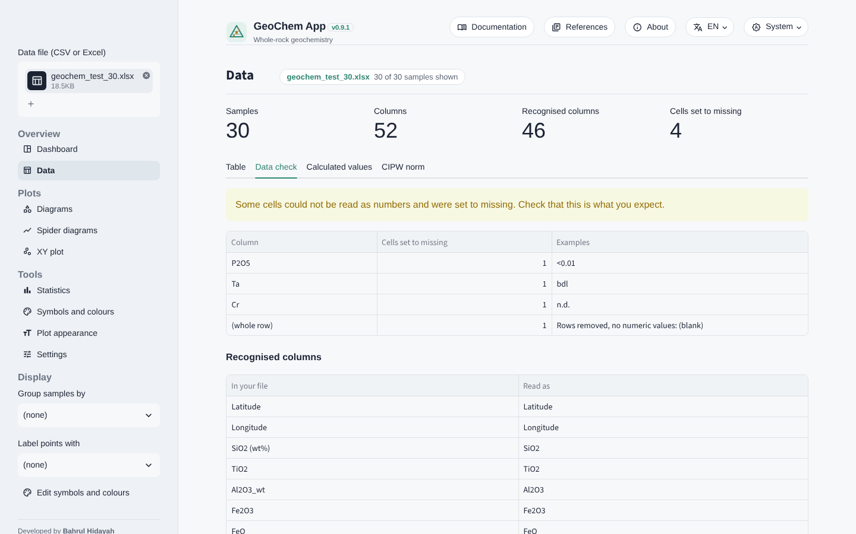
Data import made easy
// FEATURES
Lab files as they are
data_check.exe
Values like <0.01 or bdl, decimal commas and unit rows are handled automatically.
Any file layout
Column setup marks sample names, rock types and units. Save it for the next file from the same lab.
Nothing hidden
The Data check report lists every unit conversion and every cell set to missing.
GEOCHEM_APP.EXE · B. HIDAYAH
09 / 16
Notes:
Real lab files are messy: title rows, unit rows, values like less-than 0.01, decimal commas. The app reads them as they are. If the layout is unusual, the Column setup tab lets the user describe it once and save it. And the Data check tab, shown here, reports every change the app made, so nothing happens behind the user's back.

Slide 10
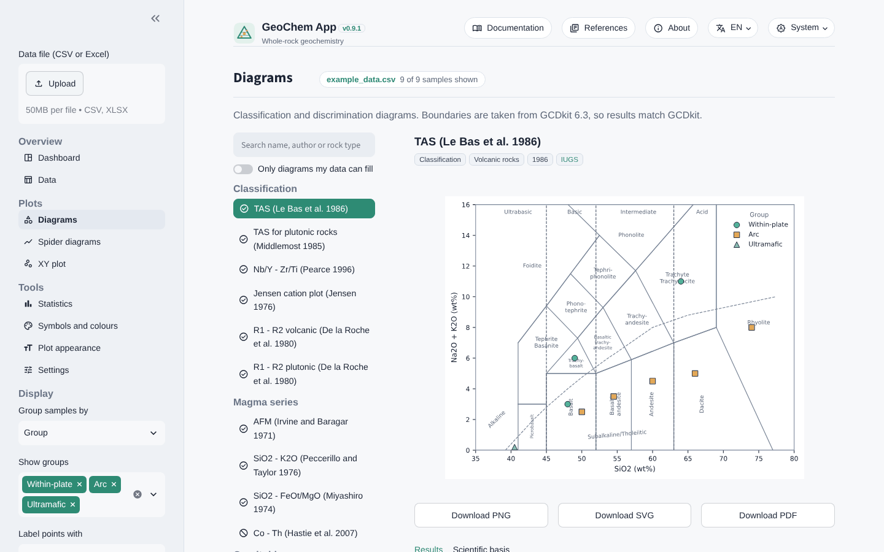
27 diagrams, 6 categories
// FEATURES
Classification
Magma series
Granitoids
diagrams.exe
Basalts and ophiolites
Ultramafic rocks
Weathering and alteration
Widely used standards
IUGS classification such as TAS (Le Bas et al. 1986) and widely cited discrimination diagrams.
Results you can defend
Each sample gets its field name. The Scientific basis tab shows formulas, valid rock types and the original reference.
GEOCHEM_APP.EXE · B. HIDAYAH
10 / 16
Notes:
The diagram catalogue has 27 classification and discrimination diagrams in six categories, from IUGS standards like TAS to tectonic discrimination diagrams for basalts and granitoids, plus ultramafic and weathering diagrams. The list can be searched and filtered to the diagrams your data can fill. For every diagram the app names the field of each sample and shows the formulas and original paper, and warns which rock types the diagram is valid for.

Slide 11
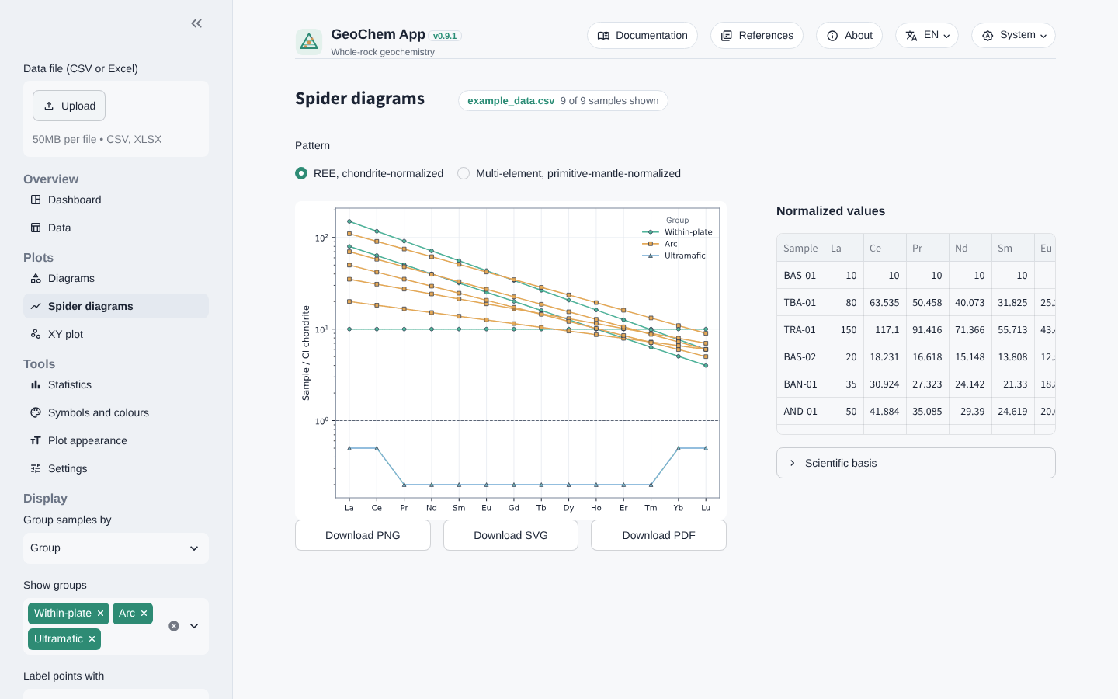
Spider plots, norms, stats
// FEATURES
Spider diagrams
spider_plot.exe
35 published normalising sets: chondrite, primitive mantle, MORB, OIB and crust (e.g. McDonough and Sun 1995).
CIPW norm
Normative minerals after Hutchison (1974, 1975), with a user-set Fe³⁺/Fe(total).
XY plots and statistics
Any column against any other, linear or log; summary statistics for each group.
GEOCHEM_APP.EXE · B. HIDAYAH
11 / 16
Notes:
Beyond classification, the app draws REE and multi-element spider diagrams with 35 published normalising sets, such as the McDonough and Sun chondrite and the Sun and McDonough primitive mantle. It calculates the CIPW norm following Hutchison, and offers free XY plots and group statistics. Values below detection limit are left out of spider patterns, and dotted lines bridge the gaps.

Slide 12
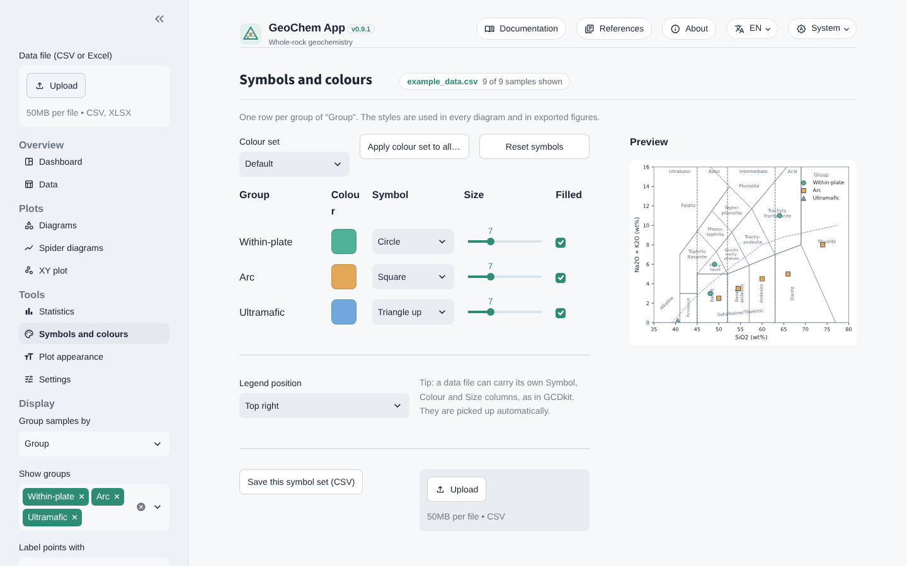
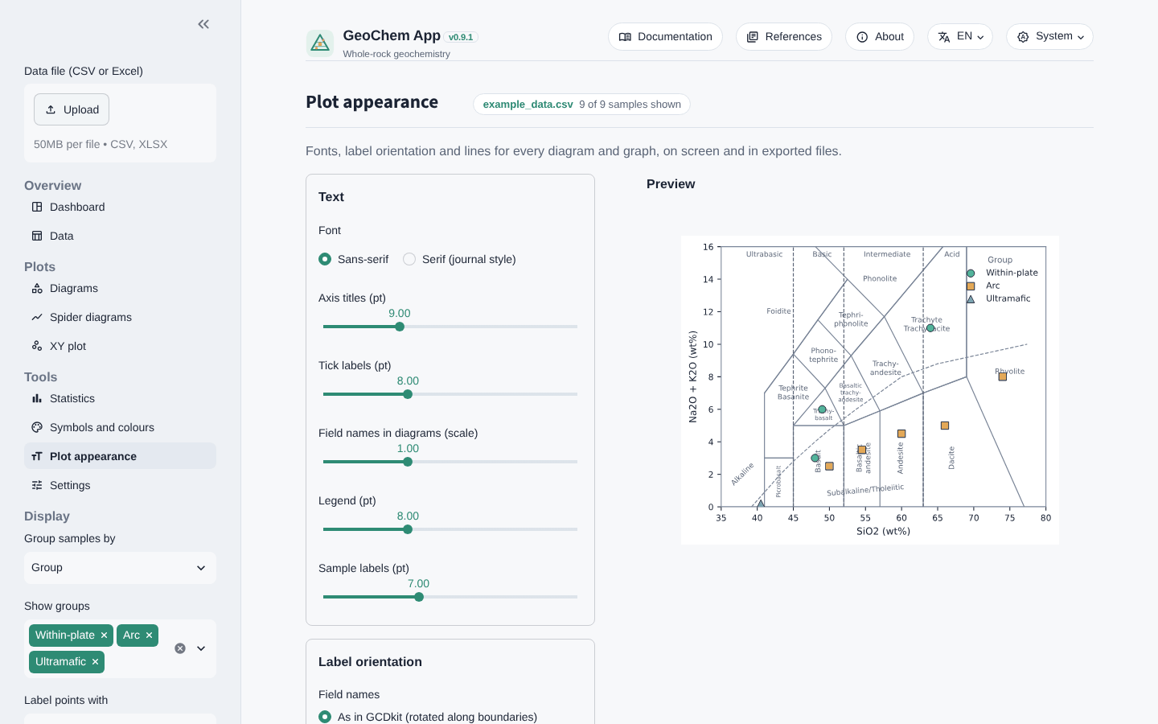
Publication-ready figures
// FEATURES
symbols.exe
appearance.exe
Symbols and colours per group, with default, colour-blind safe or greyscale palettes.
Plot appearance: fonts, labels, line widths. Export PNG (up to 600 dpi), SVG or PDF.
GEOCHEM_APP.EXE · B. HIDAYAH
12 / 16
Notes:
Figures should go straight into a thesis or paper. Each group gets its own symbol, colour and size, with a colour-blind safe palette and a greyscale option for printing. The appearance page controls fonts, label orientation and line widths. Exports are in a clean publication style: PNG up to 600 dpi, or vector SVG and PDF that can be edited in Inkscape or Illustrator.

Slide 13
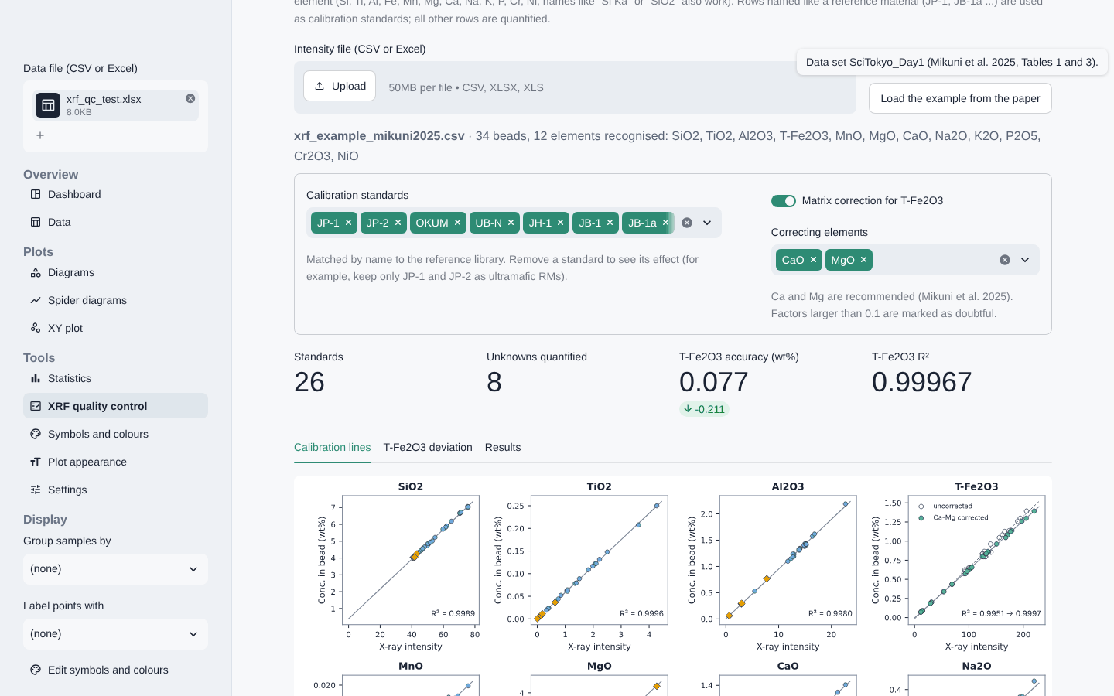
Optional: XRF quality control
// FEATURES
Mikuni et al. (2025)
xrf_qc.exe
Reference-material QC, calibration from X-ray intensities with Ca–Mg matrix correction, and an ultramafic iron check.
Why it matters
Without matrix correction, T-Fe2O3 in peridotites can be 0.6–0.7 wt% too high, which shifts Mg#.
> VALIDATION: REPRODUCES THE PAPER
0.99967
0.077
R², T-Fe2O3 line
accuracy, wt%
Sample GP13: 8.92 → 8.40 wt% T-Fe2O3, as in the paper
MIKUNI, ISHIKAWA & SATO (2025) GEOCHEM. J. 59, 299–314
13 / 16
Notes:
This optional module follows Mikuni, Ishikawa and Sato, 2025, in Geochemical Journal. It checks reference materials measured with the samples, builds calibration lines from raw X-ray intensities with a calcium–magnesium matrix correction, and flags high-MgO samples whose iron may be biased. This matters for my serpentinite and peridotite samples. Using the example data from the paper, the app reproduces the published values: R-squared 0.99967, accuracy 0.077 wt%, and GP13 corrected from 8.92 to 8.40 wt% T-Fe2O3.

Slide 14



Three ways to use it
// SHARING
Online
Portable ZIP
Source code
Any browser, also on tablets and phones. Nothing to install.
Extract and double-click on any Windows PC. No installation and no internet; data never leave the computer.
For macOS, Linux and developers: clone from GitHub, install five libraries, run with Streamlit.
geo-app-hidayah
.streamlit.app
Interface in English, Indonesian and Japanese 日本語 · light, dark or system theme
GEOCHEM_APP.EXE · B. HIDAYAH
14 / 16
Notes:
There are three ways to use the app. The online version needs only the link or this QR code, and works on phones too. For confidential data or field work without internet, the portable Windows ZIP runs fully offline. Developers and macOS or Linux users can run it from the source code. The interface is available in English, Indonesian and Japanese.

Slide 15
Research link and roadmap
// NEXT STEPS
Roadmap
For serpentinization studies
NOW · v0.11
Paulick et al. (2006)
IN THE APP
Whole-rock XRF and ICP
Al2O3/SiO2 vs MgO/SiO2, mantle array
NEXT
Ohta and Arai (2007)
IN THE APP
XRD: mineral identification
F–M–W weathering of igneous rocks
THEN
XRF ultramafic check
IN THE APP
SEM-EDX: spectra and maps
Mg# of high-MgO rocks (Mikuni et al. 2025)
LATER
Isocon (Grant 1986)
PLANNED
Raman and EPMA
Mass change during alteration
GEOCHEM_APP.EXE · B. HIDAYAH
15 / 16
Notes:
How does this connect to my research on hydrogen generation during serpentinization? The app already has the Paulick et al. 2006 diagram for peridotites and serpentinites, the Ohta and Arai F–M–W diagram, and the XRF check for high-MgO rocks. An isocon tool for mass change during alteration is planned. On the roadmap, whole-rock XRF and ICP come first, then XRD, SEM-EDX, and later Raman and EPMA, following the same principles.

Slide 16
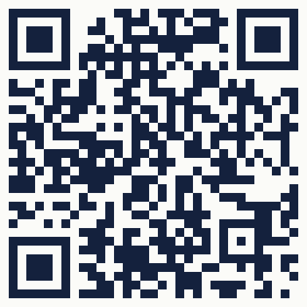
Summary
// THANK YOU · ありがとうございました
github.exe
1
A free web app for whole-rock geochemistry: 27 diagrams, spider plots, CIPW norm and XRF QC.
2
Built from widely used, published sources; every result traces back to its reference.
3
Runs online, offline or from source code; open source under GPL-3.0.
Source code, issues and feedback
Acknowledgement: boundary data adapted from open-source tools, including GCDkit (Janoušek et al. 2006, Journal of Petrology 47, 1255–1259).
github.com/
bahrulhidayah-dev/geo-app
Cite as: Hidayah B. (2026) GeoChem App: a free web application for whole-rock geochemistry, v0.11.0.
Let's collaborate on development and publication
Open to co-developing features, sharing validation datasets and co-authoring papers. Reach out via Slack and GitHuB.
GEOCHEM_APP.EXE · B. HIDAYAH
16 / 16
Notes:
To summarise: GeoChem App is a free web application for whole-rock geochemistry. It is built from widely used, published scientific sources, so every result can be traced and cited. And it can be used online, offline, or from the source code. The diagram boundary data were adapted from open-source tools, including GCDkit, which I acknowledge here. The source code is on GitHub; feedback and diagram requests are very welcome. Thank you.

